Slide 1
AN INDIVIDUAL'S RESPONSE TO DEPRESSION
MENTOR : PRATIK GAJENDRA SONAR
Submitted by
Prathyusha Badisetti
Vandana Talla
Siva Sai Krishna T
Waseem Akram

Slide 2


Slide 3
Problem Statement
To build a suitable model that will allow us to identify the depressed respondents and help them with their mental health by researching the effects of the factors that contribute to depression and predicting whether the respondent is likely to experience depression or not based on factors like cocaine, cigarettes, marijuana, crack, income range, education, and many other factors.
Why is the problem statement vital?
An estimated 3.8% of the world's population suffers from depression, including 5.0% of adults and 5.7% of persons over the age of 60. Around 280 million individuals worldwide suffer from depression. Depression is distinct from common mood swings and transient emotional reactions to problems in day-to-day living.

Slide 4
Aim
The objective of this project is to develop a prediction model using machine learning algorithms to analyze historical survey data. This model will help predict the respondents who will experience depression.
Considered data set
National Survey of Drug Use and Health (2015-2019) from Kaggle.
Reference link :
https://www.kaggle.com/bgallamoza/national-survey-of-drug-use-and-health20152019

Slide 5
Pre-processing of Data
There are specific data codes in the dataset, such as "poor data," "data not obtained," "skip," "blank," and "refused." by entering null values in their place.
All of the columns have null values.
Eliminating the null values from the target since they are unpredictable.
Null values that are present in all the other columns are corrected once the null values in the target are dropped.
Columns with a proportion of null values greater than 25% are removed.
KNN imputation is used to impute null values for the remaining columns.

Slide 6
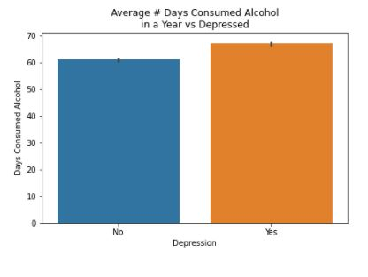
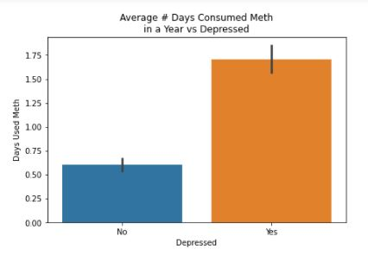
Exploratory Data Analysis & Insights:
We compared people with a history of drinking alcohol regularly over the course of a year to those who reported being depressed. The graph above shows that there are somewhat more depressed people than non-depressed people.
We compared those who regularly use meth over the course of a year with those who report being depressed. From the graph above, we can see that the number of depressed people is higher for those who have the habit than for those who do not.

Slide 7
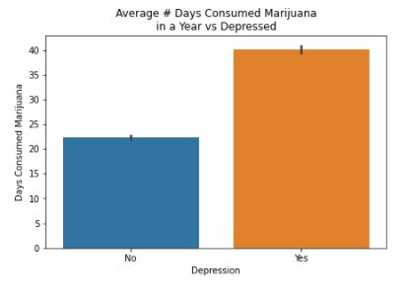
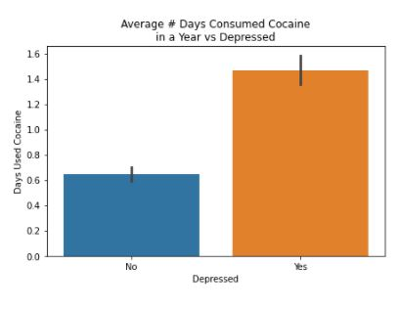
We have examined those who regularly use marijuana with those who are sad. From the graph above, it is clear that persons who regularly consume marijuana have a higher depressed count than those who don't.
We made a comparison between those who regularly use cocaine and people who are depressed. The graph above demonstrates that those who use cocaine have a higher depressive disorder incidence than those who don't use the drug.

Slide 8
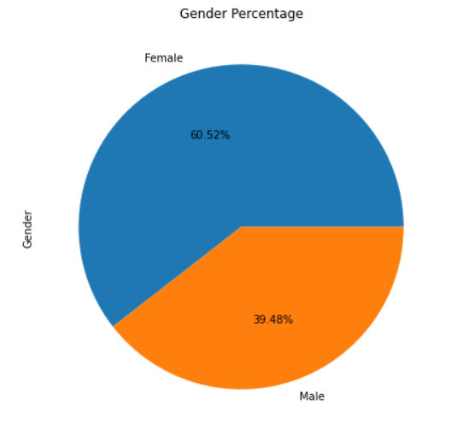
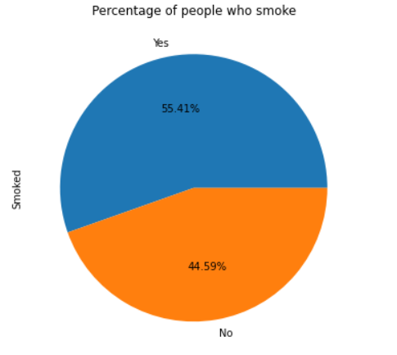
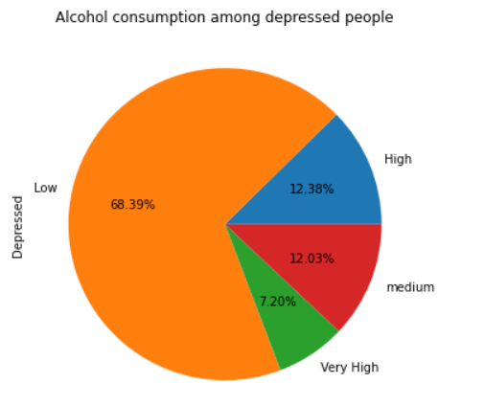
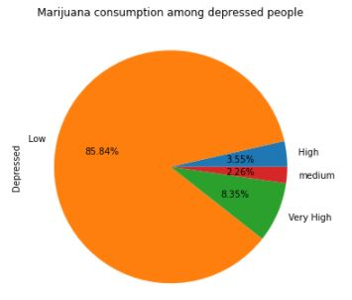
We looked at the frequency of depression with the number of persons who smoke. The pie chart shows that, compared to those who don't smoke, persons who smoke have a higher percentage of depression.
We have contrasted gender differences in depressive state. The pie chart shows that the percentage of sad people is higher among women than among men.
The pie chart is plotted for several categories of "Alcohol Consumption," and the bulk of them fall under the "Low" alcohol consumption group since they drink fewer than 60 days per year.
The marijuana usage pie chart shows many groups, and the majority of users fall into the "Low" category, using marijuana for fewer than 60 days year.

Slide 9
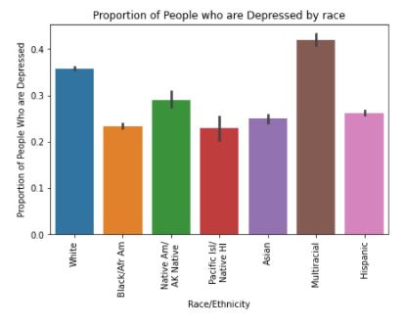
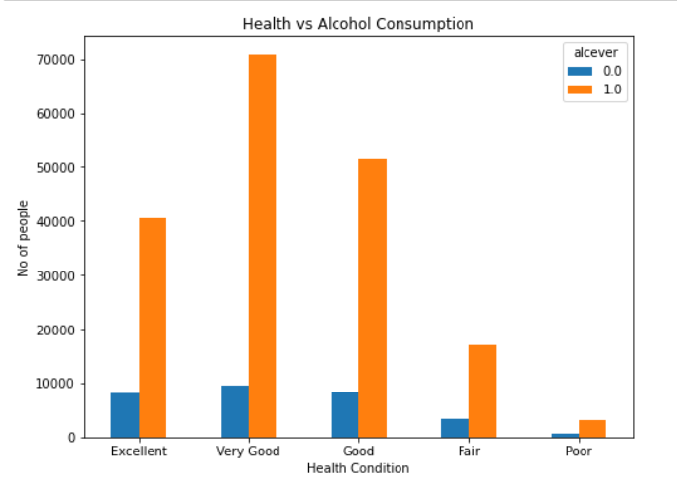
Five types of health conditions for all persons. People who are among them in "very excellent" health are more likely to consume alcohol, while those who are in "bad" health are less likely to do this even.
Multiracial people category get depressed more followed by Whites and proportion of all remaining races like Asians,blacks, is more or less same

Slide 10
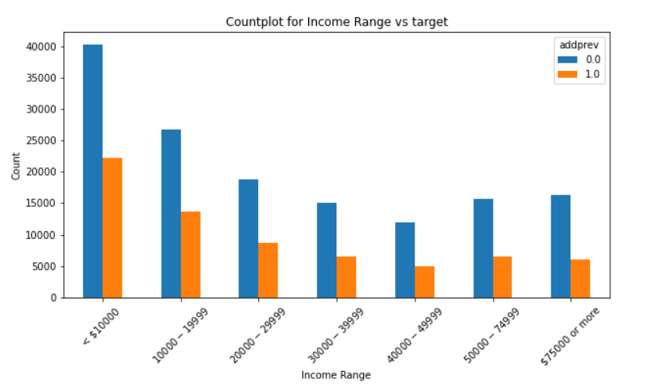
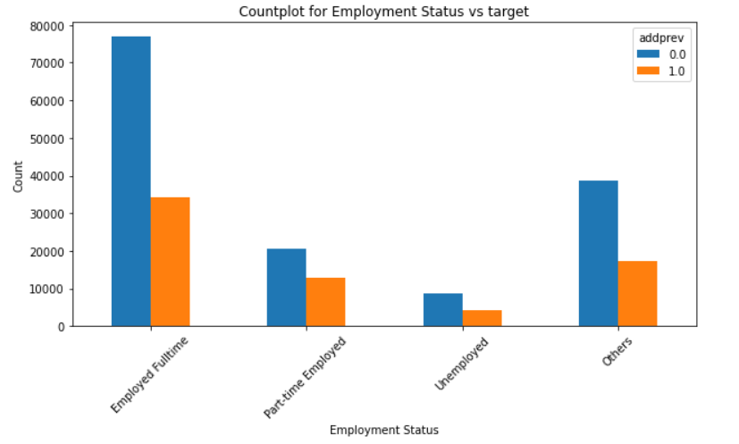
Among those who are depressed, those with low incomes are more likely to be depressed, whereas those with moderate incomes are less likely to be depressed.
People who work full-time are more likely to experience depression among those who don't. People who are not employed are less likely to suffer from depression.

Slide 11
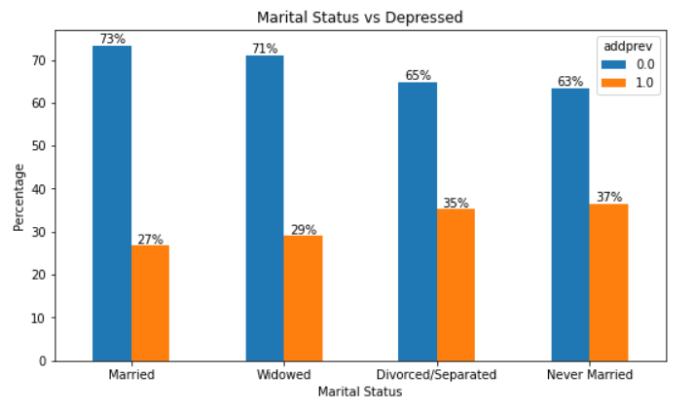
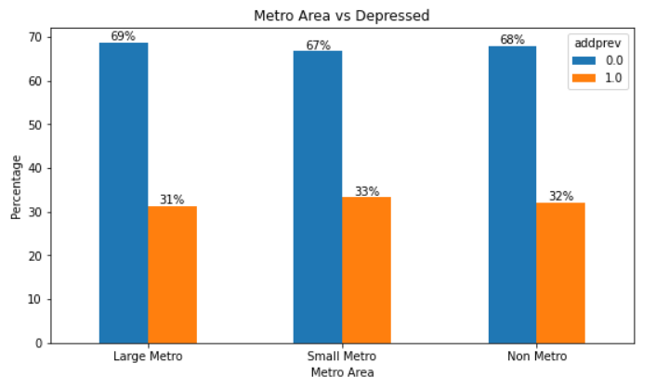
We can observe from the count plot that never married individuals are more sad than married persons when it comes to the target variable.
In the metro categories, large,small and non metro non-metro, of the count plot, there was a little variance in the number of sad persons. Small metro areas have the highest rates of depression among these three.

Slide 12
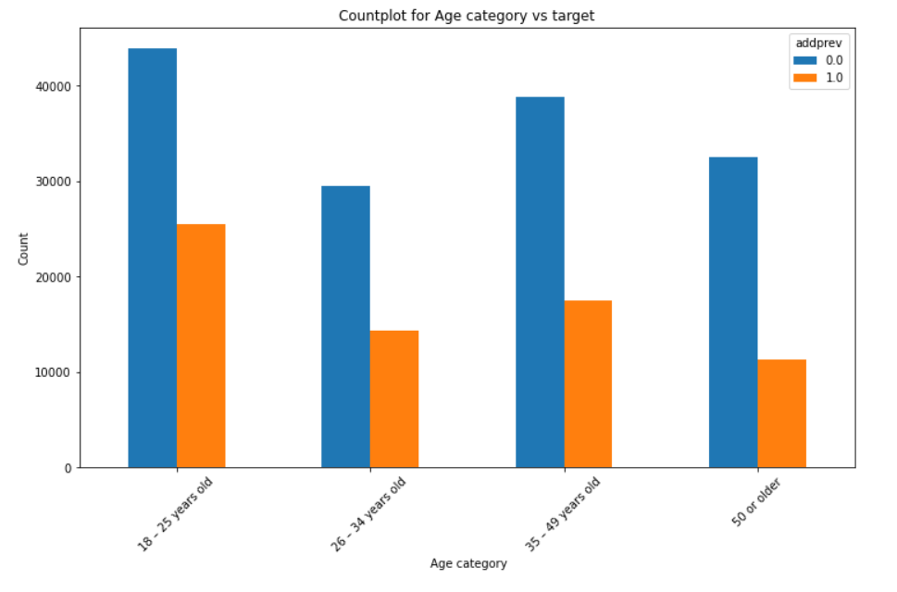
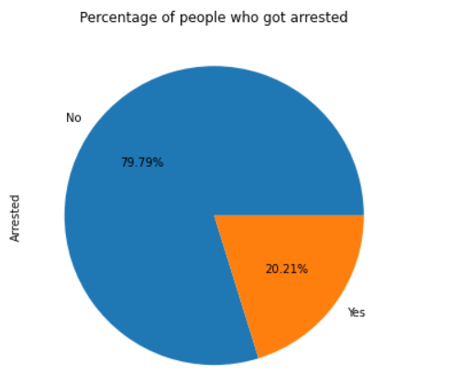
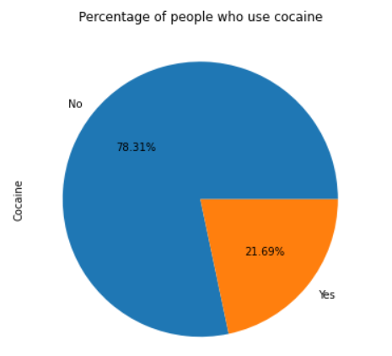
According to the pie chart, there are more sad persons who are not arrested than there are depressed people who are arrested.
According to the count plot above, those between the ages of 18 and 25 are more likely to be depressed than those between the ages of 26 and 34, while those between the ages of 50 and beyond are less likely to be depressed.
According to the pie chart, Large percentage of depressed people do not take cocaine.

Slide 13
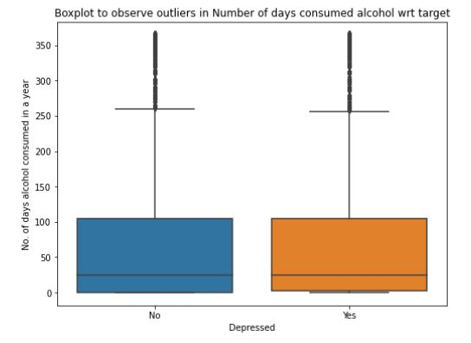
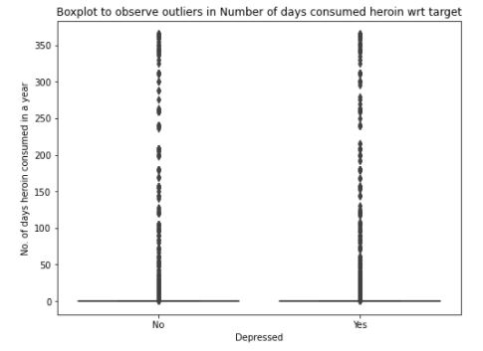
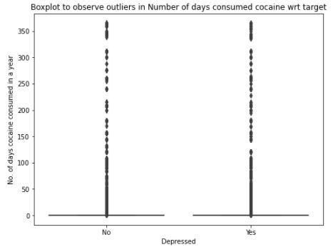
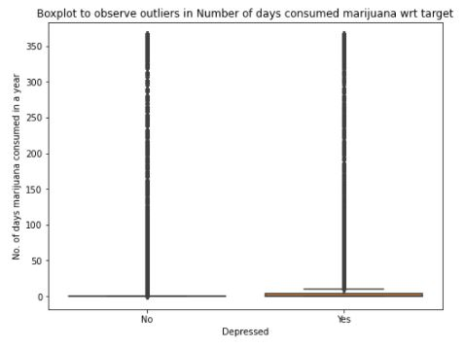
Outlier Treatment
The target variable cannot be differentiated in the outliers, as seen in the graph image, and this is true for all continuous variables. As a result, while developing the model for the analysis, the outliers must be taken into account.

Slide 14
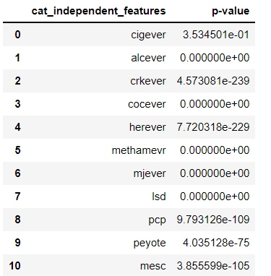
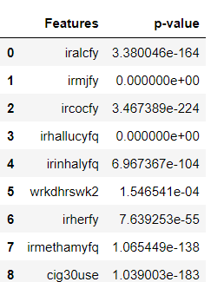
Statistical Test
Hypothesis testing for categorical features:
Null hypothesis H₀ : This feature is not significant in predicting target Alternate Hypothesis H_{a} : The feature is significant in predicting target
Chi-square test results for all categorical columns show p values less than 0.05, rejecting the null hypothesis.
Hypothesis testing for continuous features:
Null hypothesis H₀ : This feature is not significant in predicting target Alternate Hypothesis H_{a} : The feature is significant in predicting target
As p values are less than 0.05 for all the continuous columns on performing two sample t-test of independence therefore rejecting null hypothesis i.e., all the features are significant in predicting target.

Slide 15
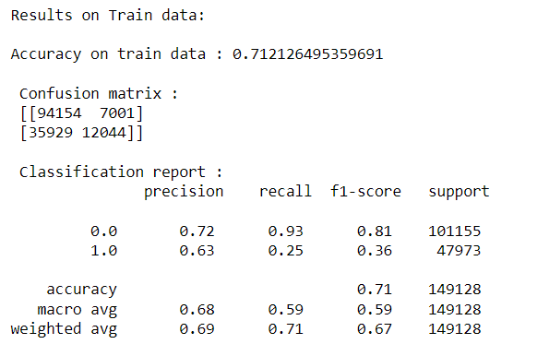
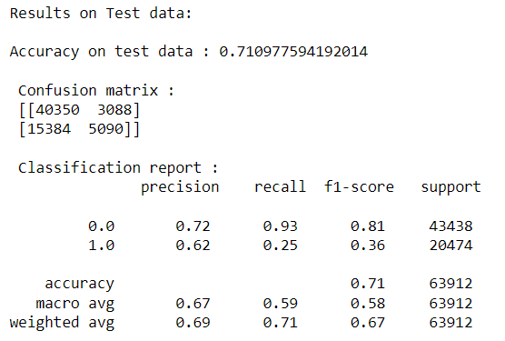
Base Model:
Logistic Regression:
Since Logistic Regression is simpler to use, interpret, and train than that of other models, it was chosen as the base model.
Performing the Logistic Regression after conventional scaler transformation of the independent variables.

Slide 16
The accuracy of the base model for the train split is 71.02%, whereas the accuracy of the test split is 71.09%.
For the not depressed class and the depressed class, the recall score for the base model is 0.93 and 0.25, respectively.
To achieve the best results, we created models using Decision Tree, Random Forest, Boost, KNN Classifier, and Gaussian NB on top of the original model.
We utilized Grid Search CV to identify the ideal parameters for each of these models.
Boost, Gradient, and Random Forest Hyper Parameter Tuning:
n Estimators, Min Samples Leaf, Min Samples Split, Gamma,
and Learning Rate.
GridsearchCV best parameters obtained for XGBoost:
max_depth=9
gamma=0
n_estimators=100
learning_rate=0.1
We used Smote (synthetic minority oversampling approach) to solve the imbalanced problem since our dataset is unbalanced, which prevents us from achieving the optimal performance for our model.

Slide 17
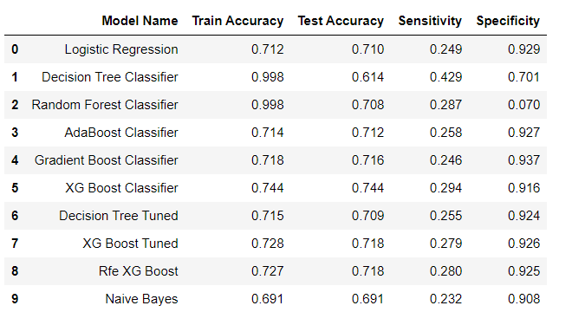
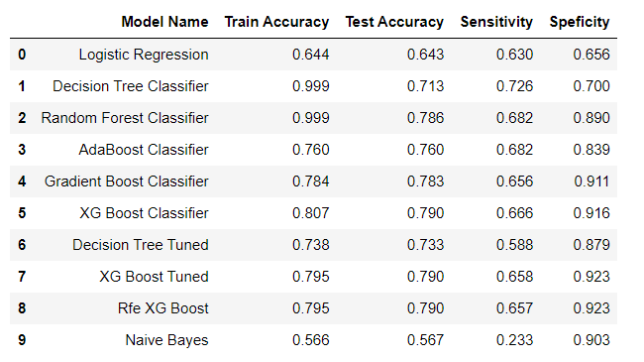
Metrics Before SMOTE:
Metrics After SMOTE:
We find that XG-Boost performs just slightly better than other models when comparing the Train Accuracy, Test Accuracy, Sensitivity, and Specificity.
The sensitivity of logistic regression is minimal.
The False Negative Rate is High for Decision Tree, Random Forest, K Nearest Neighbors, Stacking, Gradient Boosting, and Adaptive Boosting.
The least sensitive models are Random Forest and K Nearest Neighbors. When compared to the other models, Random Forest and Gradient Boosting provide an extremely high True Negative Rate.

Slide 18
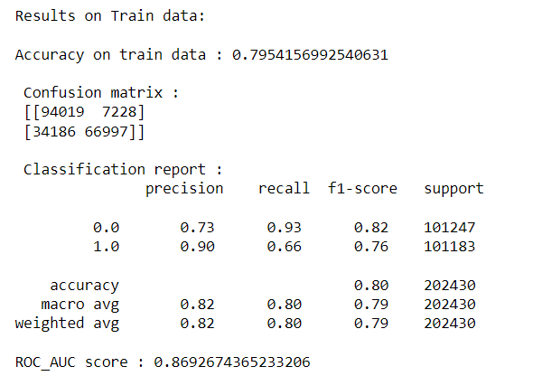
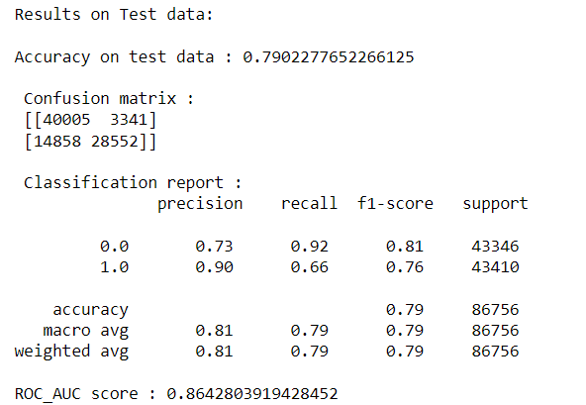
XG BOOST Tuned:

Slide 19
Inferences and Discussion
The models, from the base model to the optimized models, have performed rather well, with models of different accuracy. For example, some models matched test data well overall, while others had a low True Positive Rate, and still others did not.
With a True Positive Rate (Sensitivity) of 0.658, the XG-Boost model is able to connect with about 65% of those who are sad.
It would be really horrible not to approach someone who is truly depressed and unable to give support since our purpose is to either help individuals who are experiencing depression or prevent those who are prone to depression.
We will select our XG-Boost Classifier since it has the maximum sensitivity to prevent False negatives. Our XG-Boost Classifier, which has the maximum sensitivity, will be used to prevent False negatives.

Slide 20
Conclusions
This study aimed at applying the machine learning techniques to predict the people who are prone to depression. Based on the analysis of the results, XG-Boost has the higher sensitivity with accuracy of 65.1%.
Health institutions and hospitals can use machine learning to assess the people/patients who are prone to depression by helping them offering counselling and medication.

Slide 21
THANK YOU

